Slide 1

Exam AZ-303: Microsoft Azure Architect Technologies Crash Course
Tim Warner

Slide 2
Day 2 of 2 Agenda
Sweep up yesterday’s shavings
Platform services
Data platform
Identity
Monitoring

Slide 3
Course Materials
timw.info/az303

Slide 4

Session Recordings

Slide 5

Tim's Certification Study Model
Content knowledge
Test-taking skills
Practical application

Slide 6

Load Balancing

Slide 7

Traffic Manager

Slide 8

Front Door Service

Slide 9






Azure App Service
Web Apps
Web Apps for Containers
API Management
Functions
Logic Apps

Slide 10


Docker Lifecycle
https://timw.info/89a04

Slide 11


Docker Container Lifecycle
https://timw.info/3635f

Slide 12



Running Containers in Azure
Azure Container Instances
Azure Container Registry
Azure Kubernetes Service (AKS)

Slide 13

Tenant vs. Subscription

Slide 14

Azure Management Scopes
/ Tenant root
Inheritence:
RBAC
Policy
No inheritence:
Tags

Slide 15

Hybrid Identity

Slide 16

Thank you!
Course materials: timw.info/az303
Twitter: @TechTrainerTim
Work: timw.info/ps
Web: TechTrainerTim.com

Slide 17
Azure Compute

Slide 18
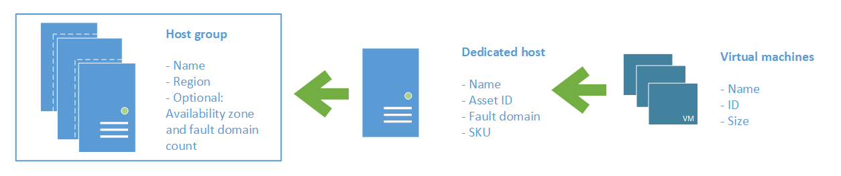
Azure VM Dedicated Host

Slide 19
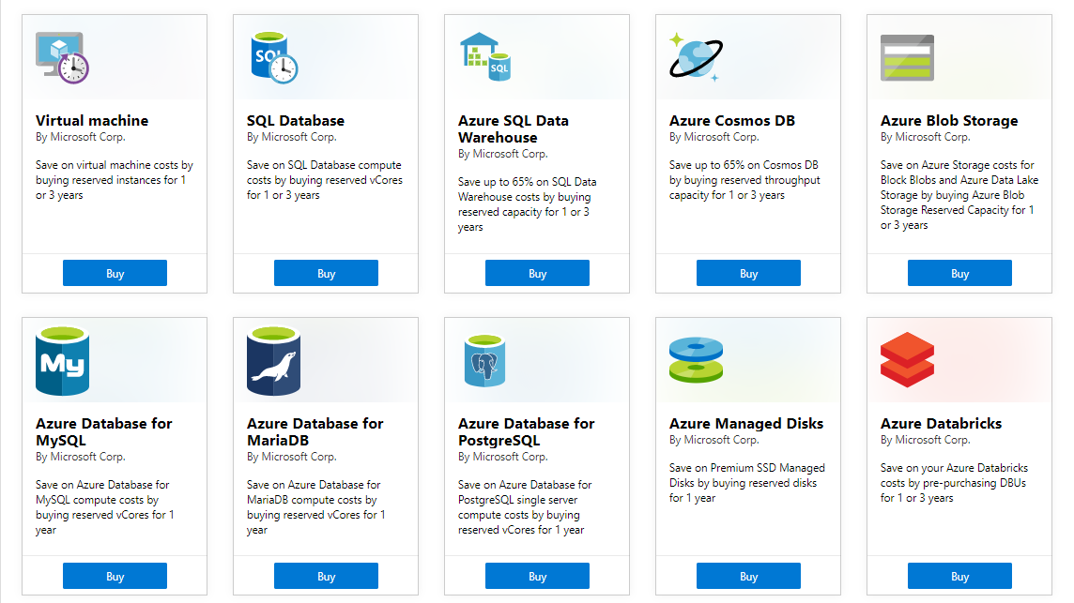
Azure Reservations

Slide 20

VM Scale Sets

Slide 21
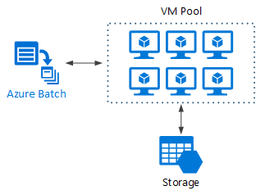
Azure Batch

Slide 22

Availability Set

Slide 23

Availability Zone

Slide 24
Load Balancing

Slide 25

VM Networking

Slide 26

VNet Peering

Slide 27

Hybrid Networking

Slide 28

Network Virtual Appliance

Slide 29

Azure Load Balancer

Slide 30

Application Gateway

Slide 31
Authentication

Slide 32

Azure Subscriptions

Slide 33

Passthrough Authentication

Slide 34

Seamless Single Sign-on

Slide 35
Azure Storage

Slide 36
Storage Account Replication
1
3
3
2
LRS
ZRS

Slide 37
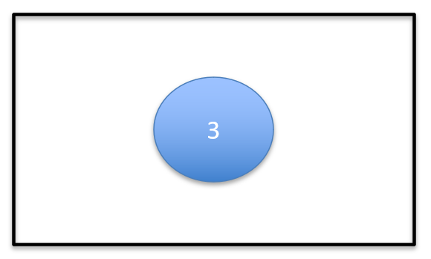
Storage Account Replication
1
3
1
3
2
2
GRS / RA-GRS

Slide 38
Storage Account Replication
1
3
1
3
2
2
GZRS / RA-GZRS

Slide 39
Governance

Slide 40
Azure Management Scopes
/ Tenant Root

Slide 41
App Architecture

Slide 42

Event Architecture

Slide 43
Data Platform

Slide 44

Always Encrypted

Slide 45
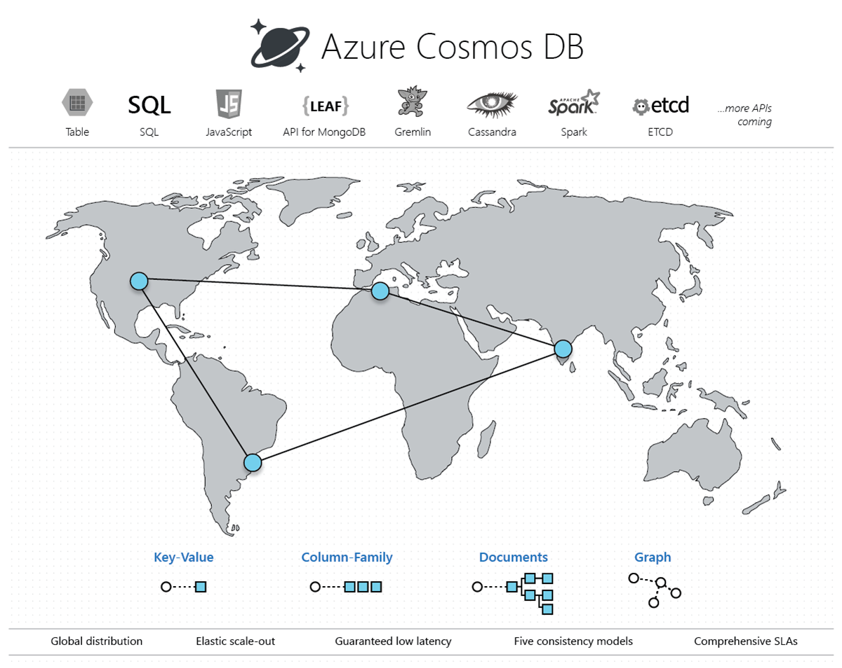
Cosmos DB

Slide 46
Exam AZ-303 Item Types

Slide 47

Multiple Choice

Slide 48
Repeated Scenario
You need to move an Azure VM to another hardware host.
Solution: You redeploy the VM.
Does this solution meet the goal?
Yes
No

Slide 49

Select and Place

Slide 50

Build List and Reorder

Slide 51

Active Screen/Fill in the Blank

Slide 52

Case Study

Slide 53






Performance-Based Lab

Slide 54
Microsoft Online Testing

Slide 55
Microsoft Online Testing Process
timw.info/online

Slide 56

Microsoft Online Testing Process

Slide 57

Microsoft Online Testing Process

Slide 58

Microsoft Online Testing Process

Slide 59

Microsoft Online Testing Process

Slide 60

Microsoft Online Testing Process

Slide 61

Microsoft Online Testing Process

Slide 62

Microsoft Online Testing Process

Slide 63
AZ-303 Exam Strategy
Focus your skills accordingly:
60 percent Azure portal
20 percent Azure PowerShell
10 percent Azure CLI
10 percent KQL
Expect performance-based labs, but be thankful if you don't see 'em

